Slide 1

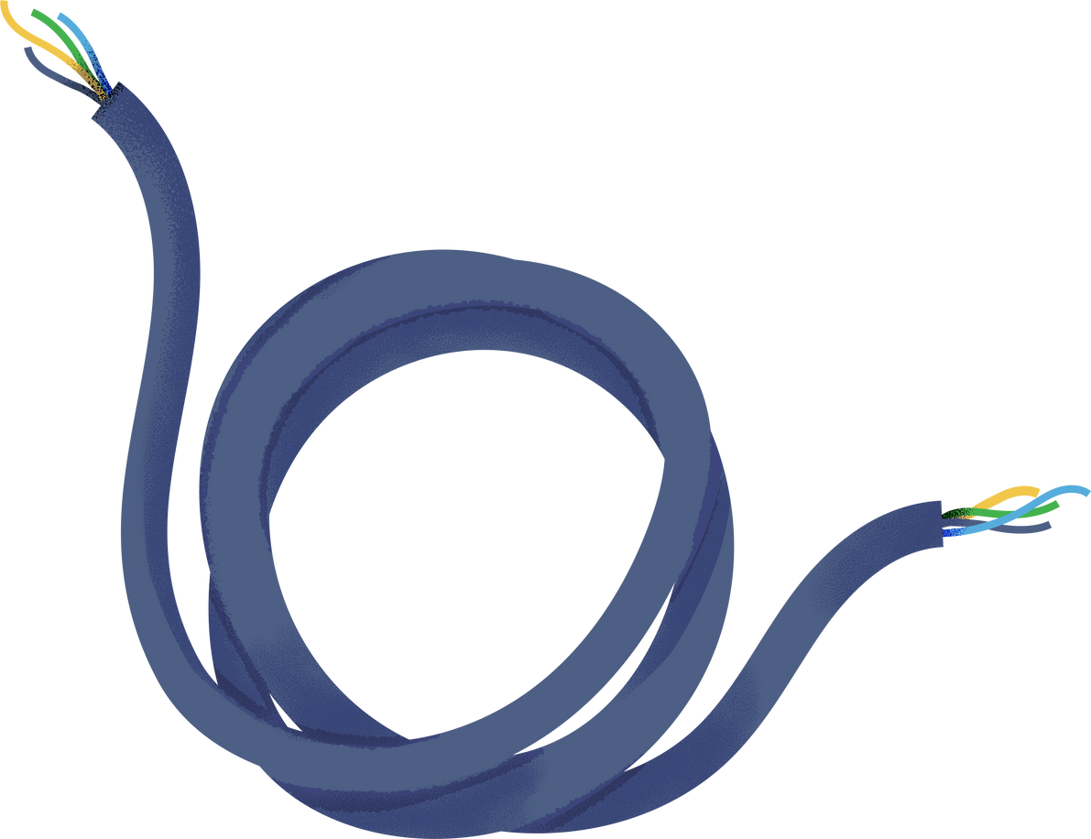







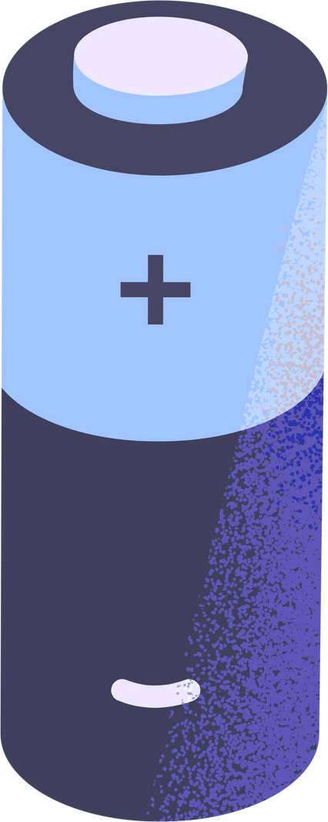


Energy Harvesting Techniques for IoT

Slide 2
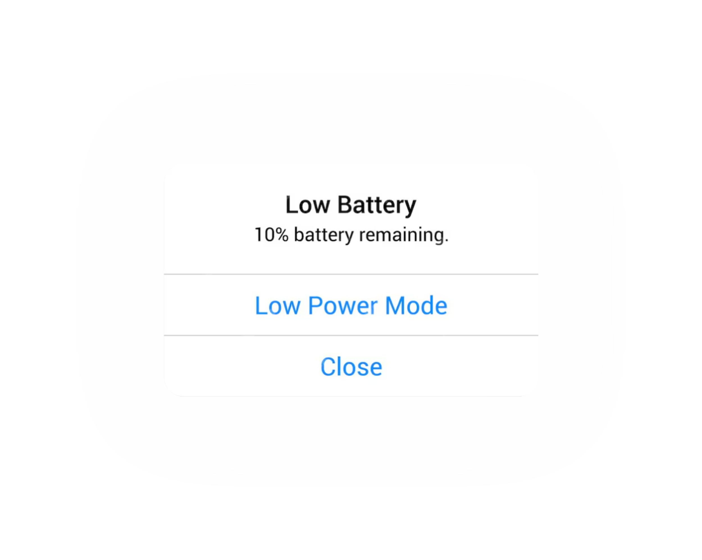


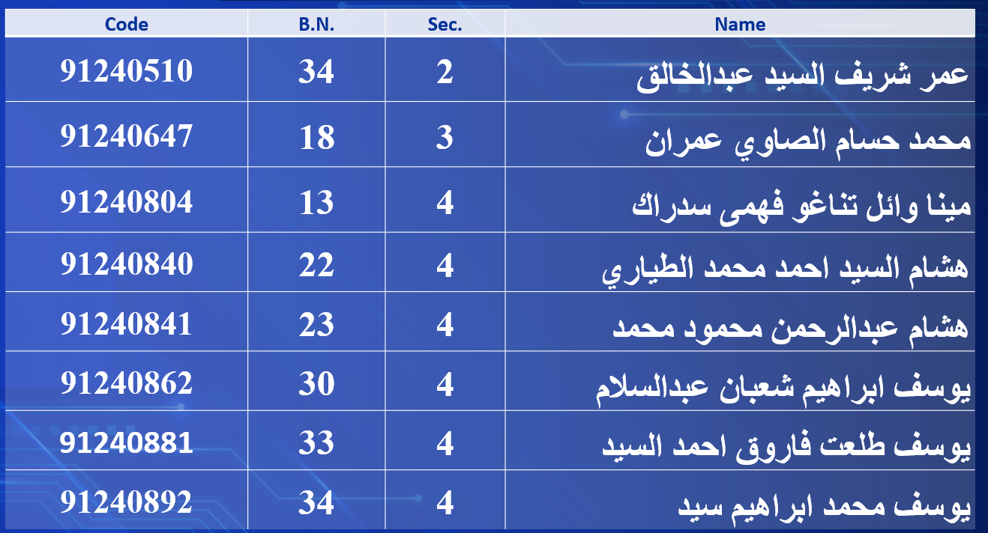
Team Members

Slide 3
Energy Harvesting Techniques for IoT

Slide 4
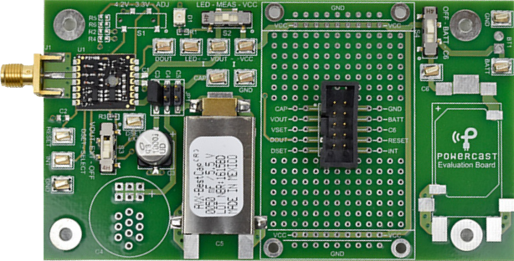
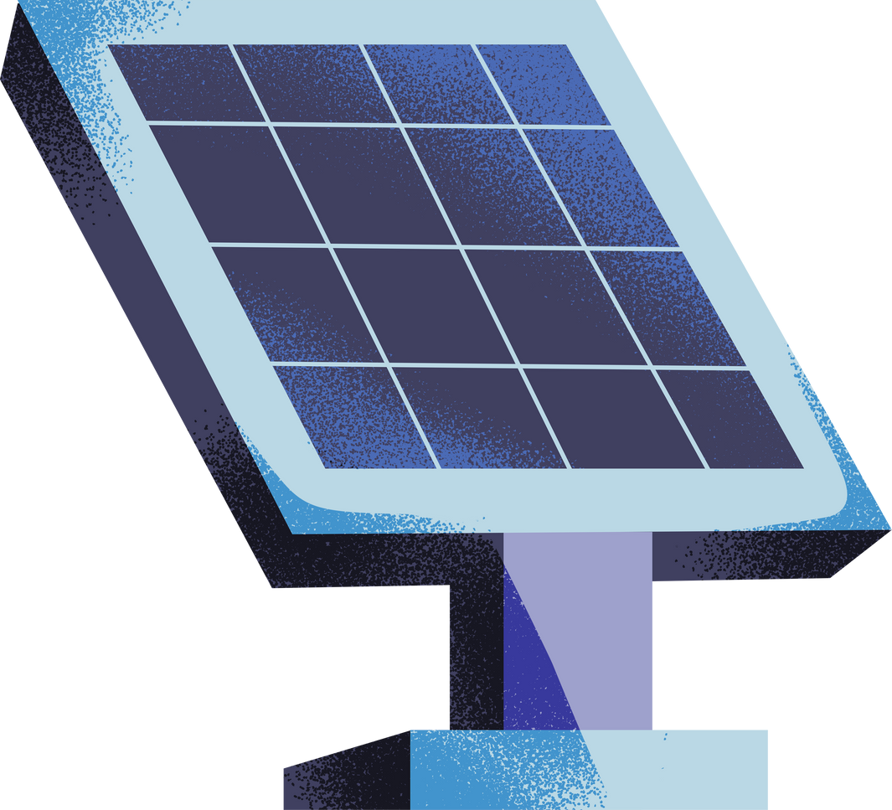
ABSTRACT
Traditional IoT devices rely on power sources, which are limited, making them inefficient for long-term deployment. Energy harvesting offers a sustainable solution for powering IoT devices by converting ambient energy sources such as solar, thermal, and vibrational energy into electricity. This reduces dependence on conventional power storage and enables long term, self-sustaining operation. This study explores various energy harvesting scenarios and optimizes energy usage through duty cycling strategies.

Slide 5
1. Mathematical Modeling and Methodology

Slide 6

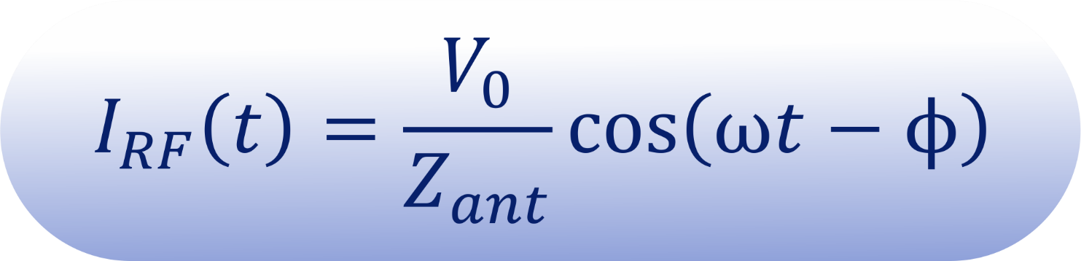


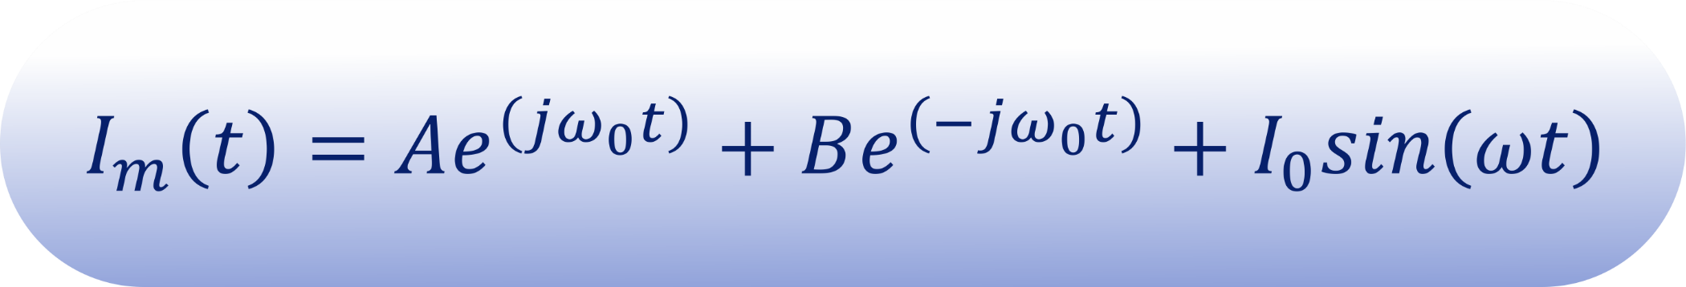
Mathematical Modeling and Methodology
1
The Transmission Antenna
The RF current induced in the antenna due to electromagnetic coupling
2
The Matching Network
Matching Network current

Slide 7

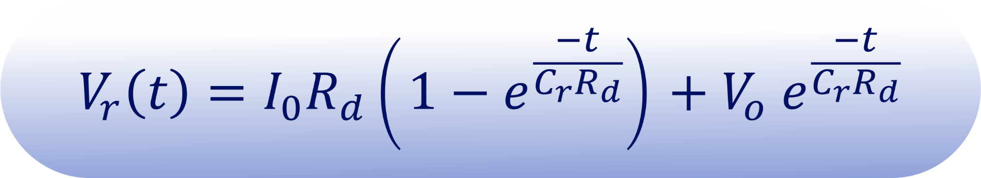

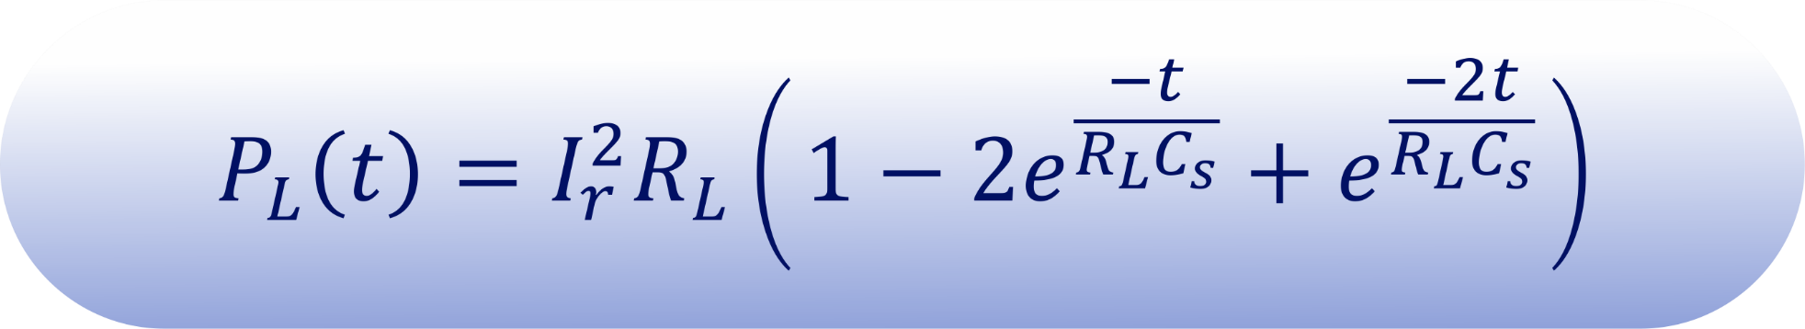
Mathematical Modeling and Methodology
3
Multi-Stage Rectifier
Rectified Voltage across capacitor
4
Load Power Consumption

Slide 8
2. Simulation and Results

Slide 9


Simulations and Results
1
Efficiency Analysis of RF-to-DC conversion
• Converts incident RF energy to DC power.
• Stores harvested energy in an external capacitor.
• Implements threshold-based voltage regulation:
- Activates output when capacitor voltage reaches upper threshold.
- Deactivates output when voltage falls below lower threshold.
• Provides stable DC output voltage for connected loads.

Slide 10

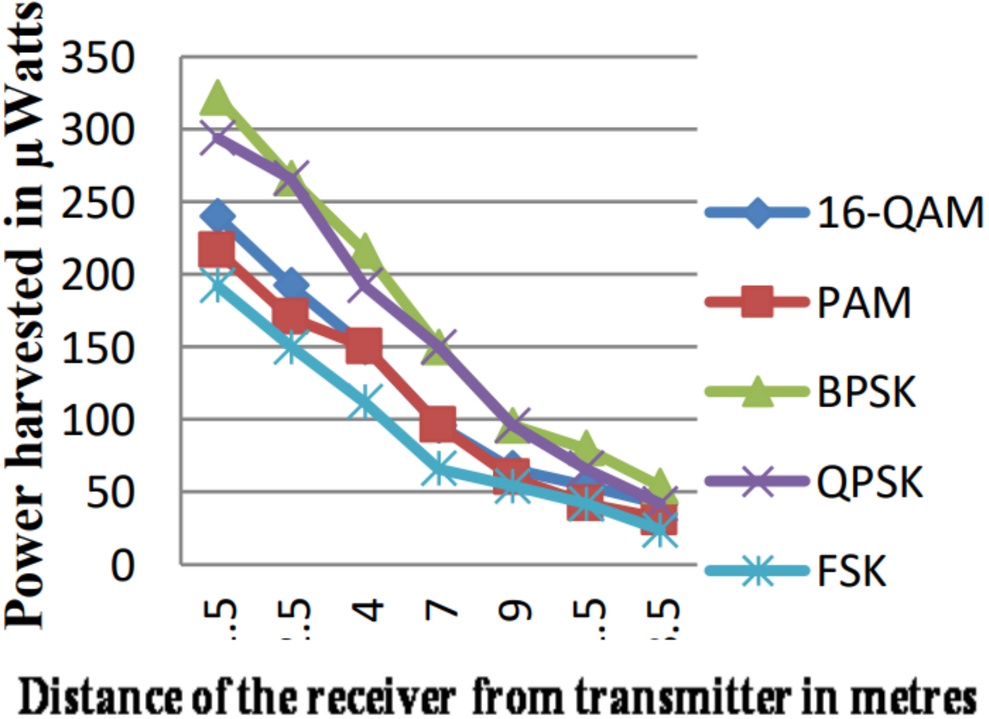
Simulations and Results
1
Efficiency Analysis of RF-to-DC conversion
Different modulation scheme
harvested energy
Map showing the locations where the transmit and receive antenna are placed

Slide 11
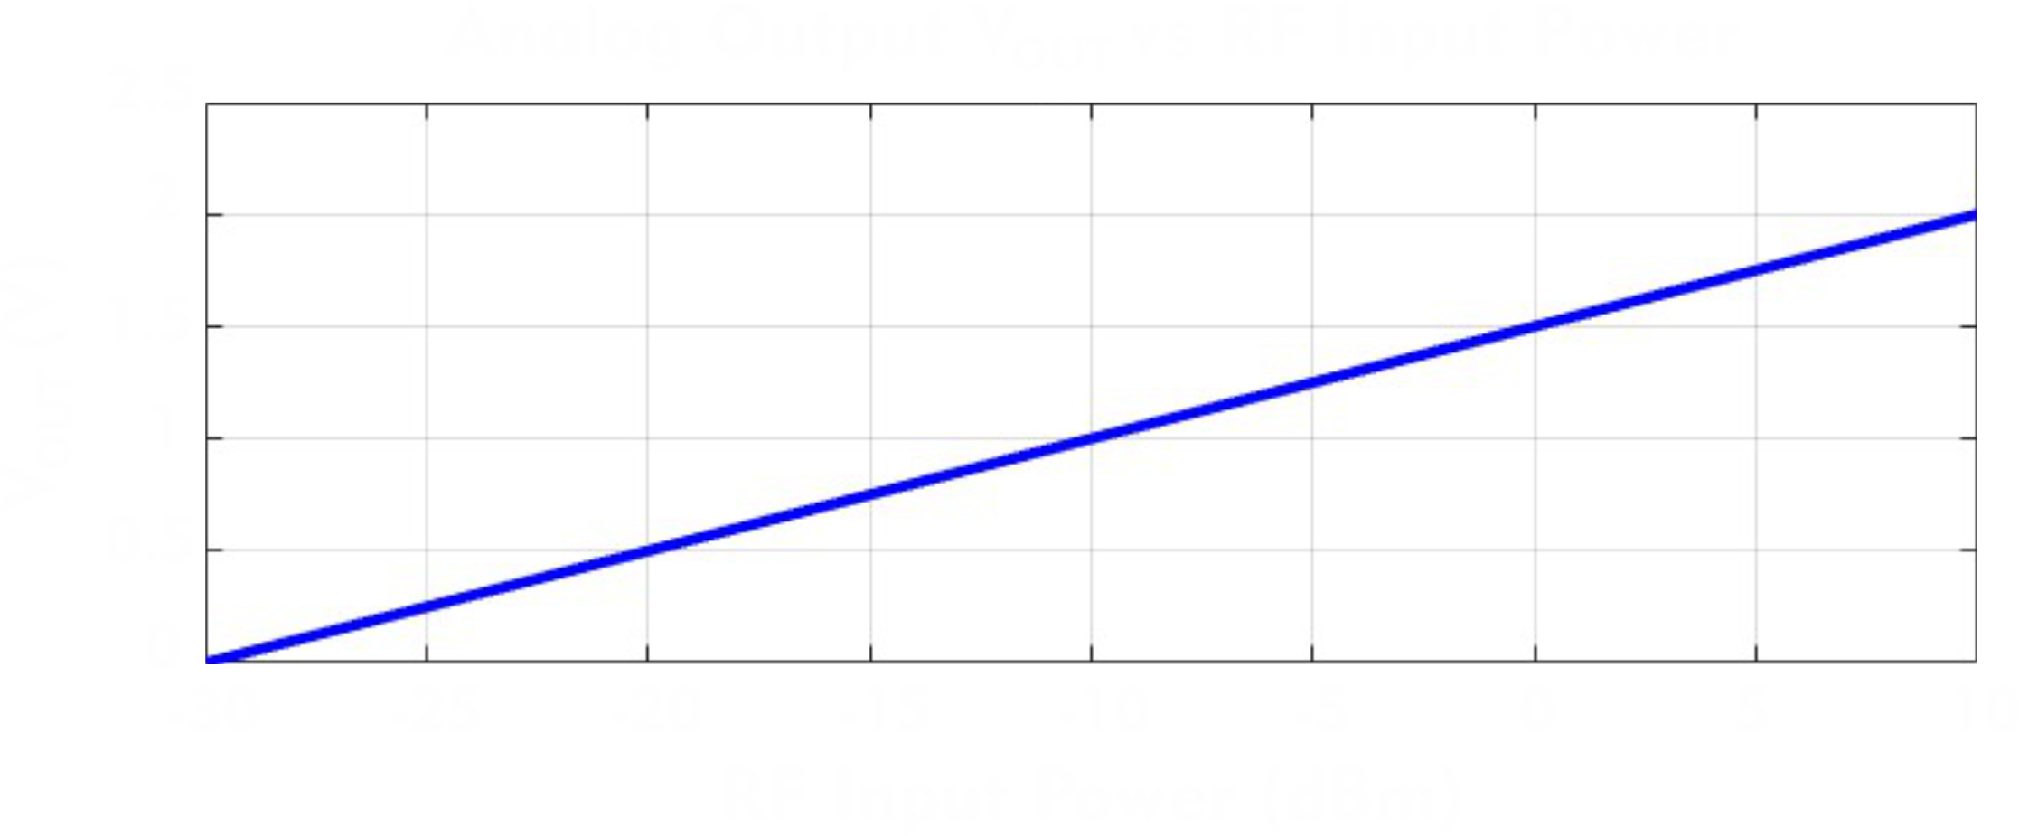

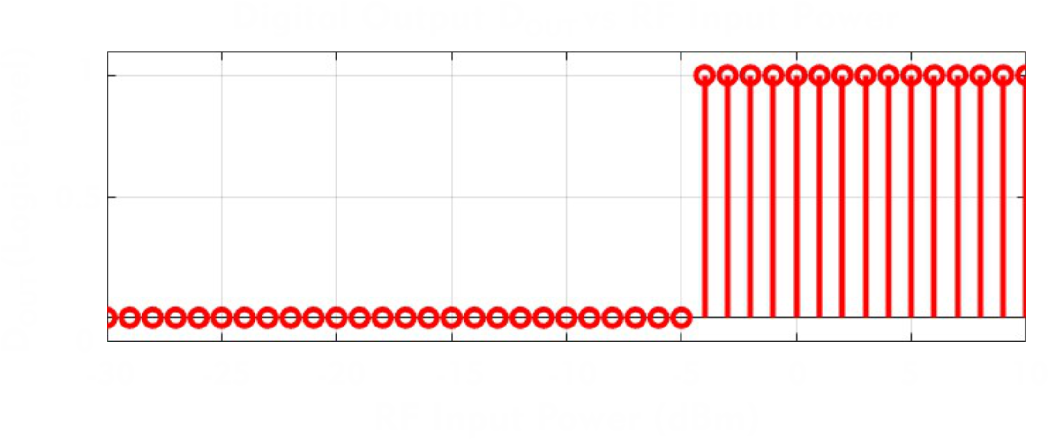
Simulations and Results
2
Our Contribution

Slide 12
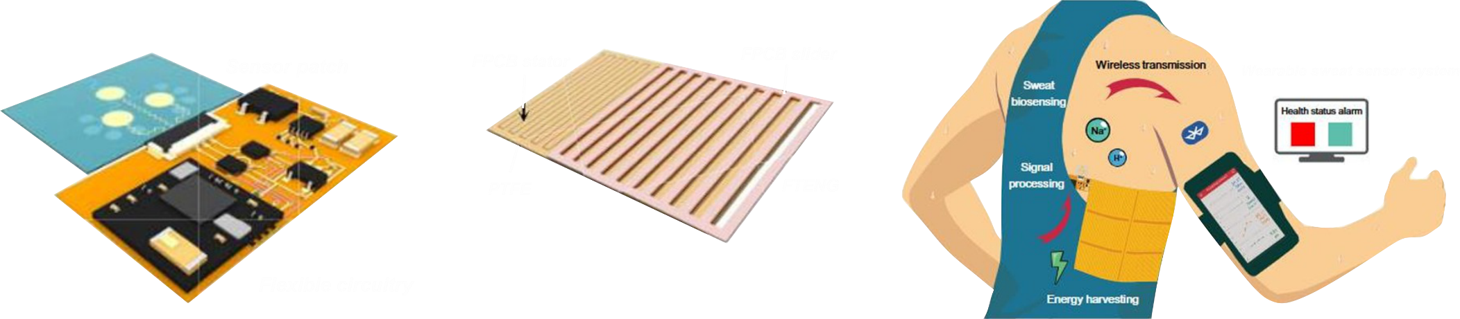


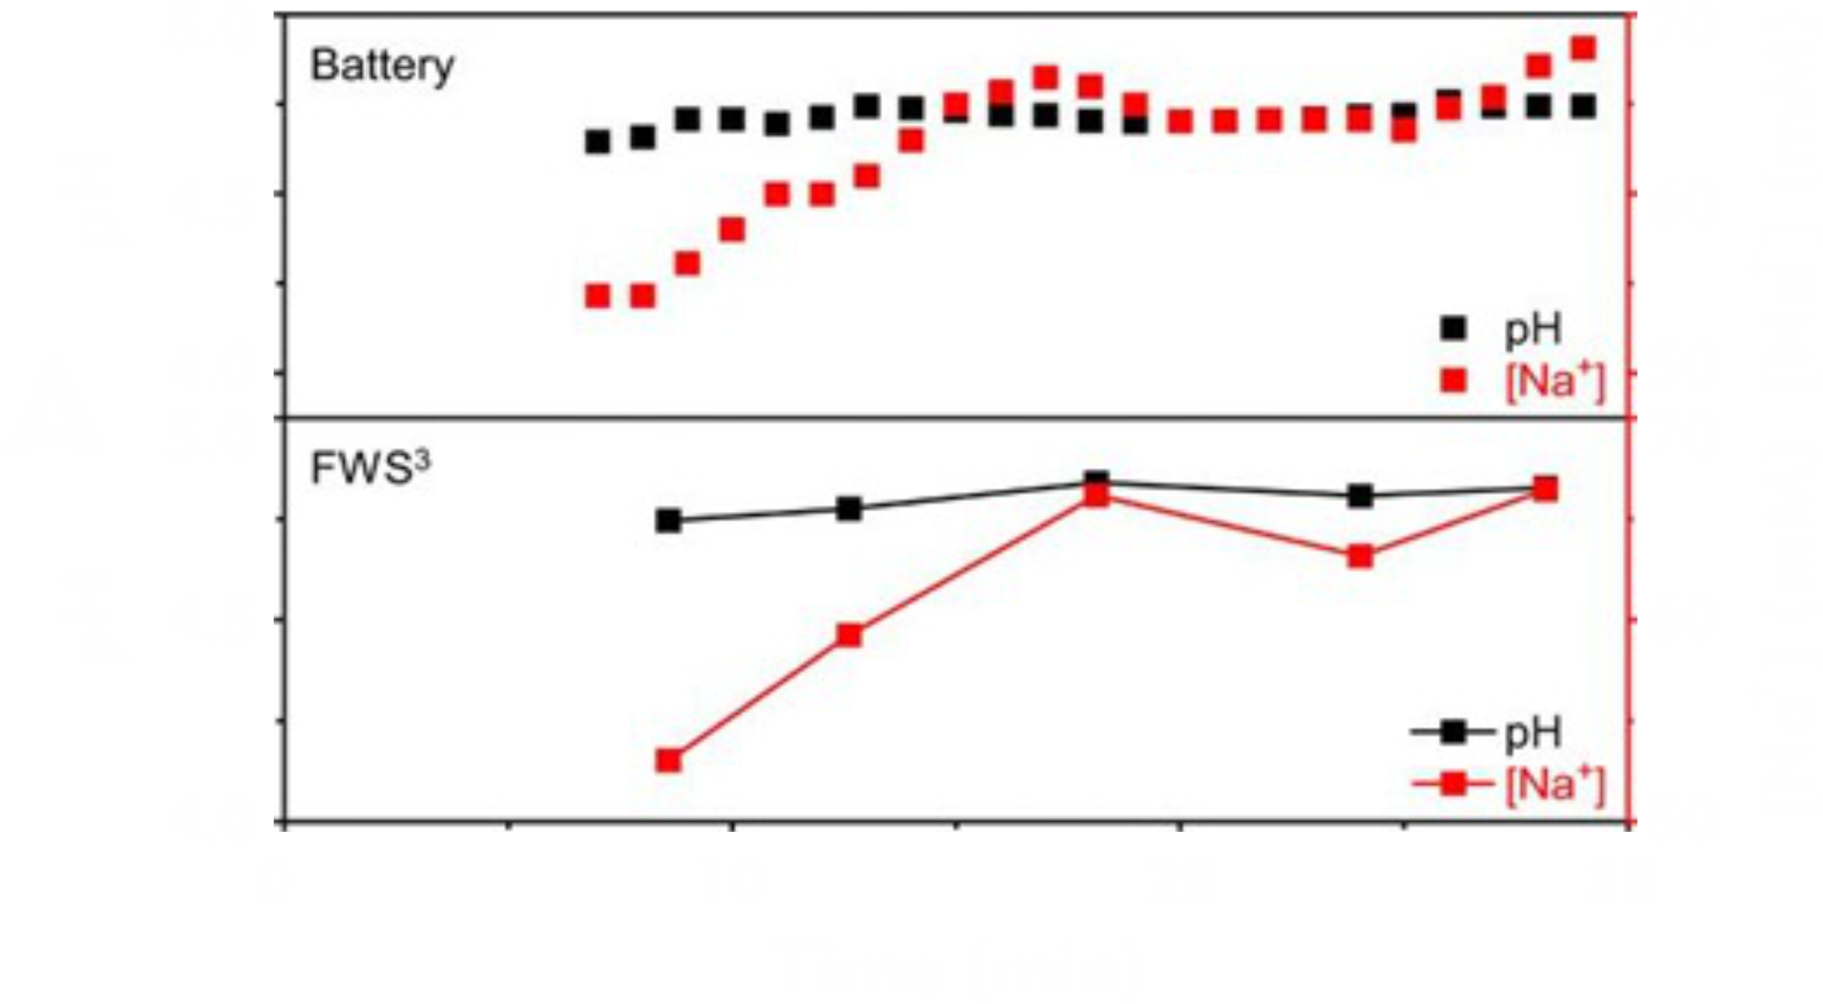
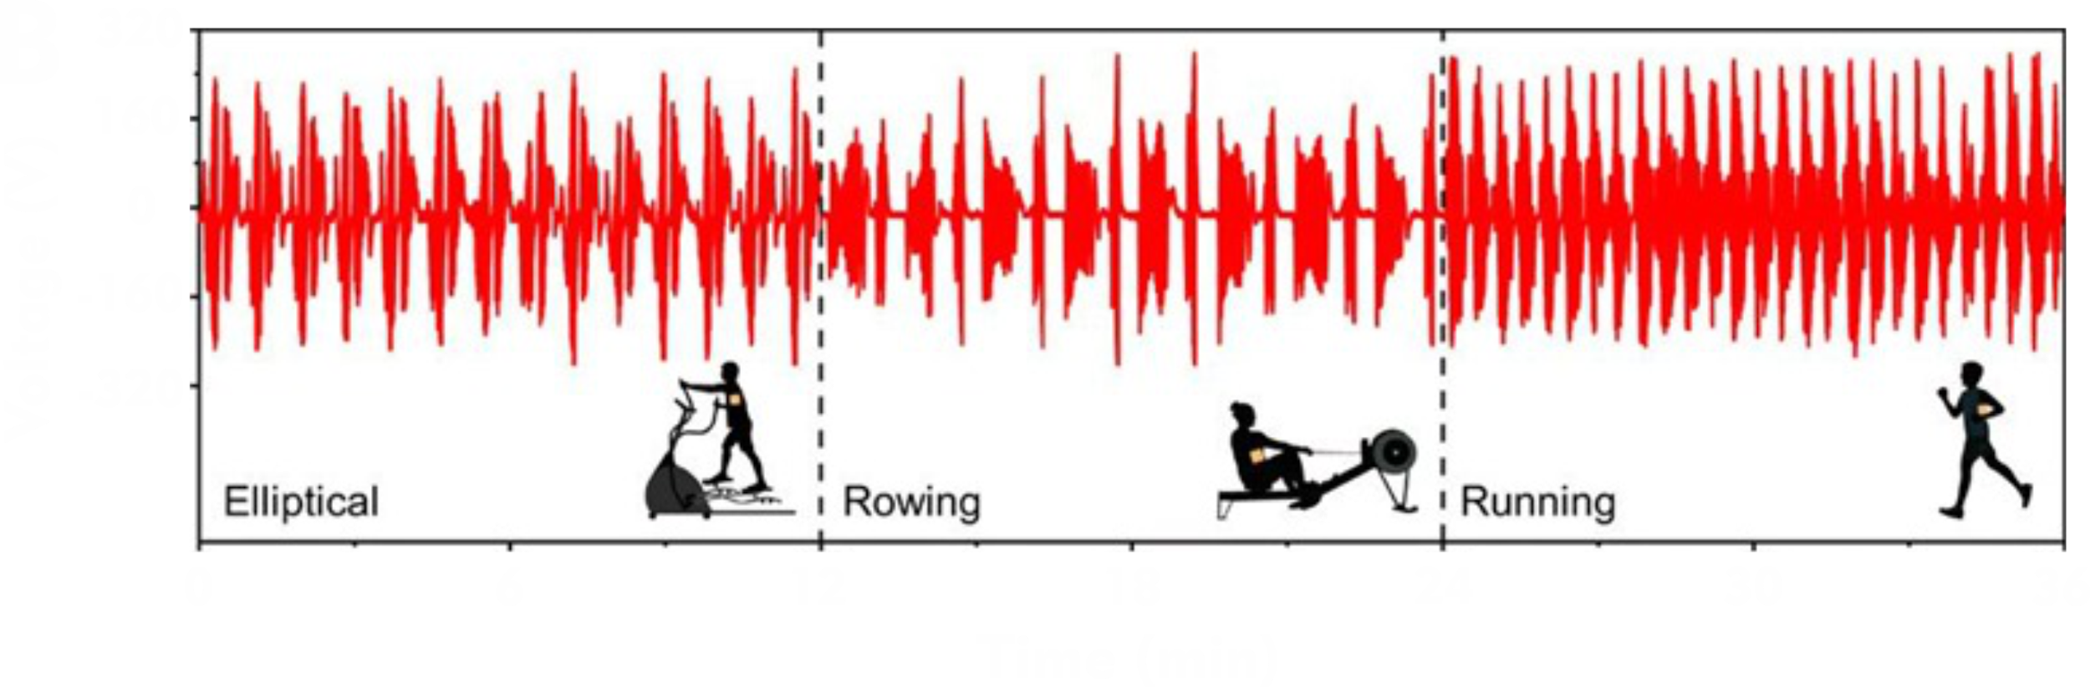
Simulations and Results
3
More Energy Harvesting Techniques
Ultra-thin epidermal piezoelectric sensor for self-powered, real-time arterial pulse monitoring.
Real-time sweat pH obtained from the wearable systems charged by a lithium battery and by an FTENG
B
A
The system’s power generation during exercise.

Slide 13

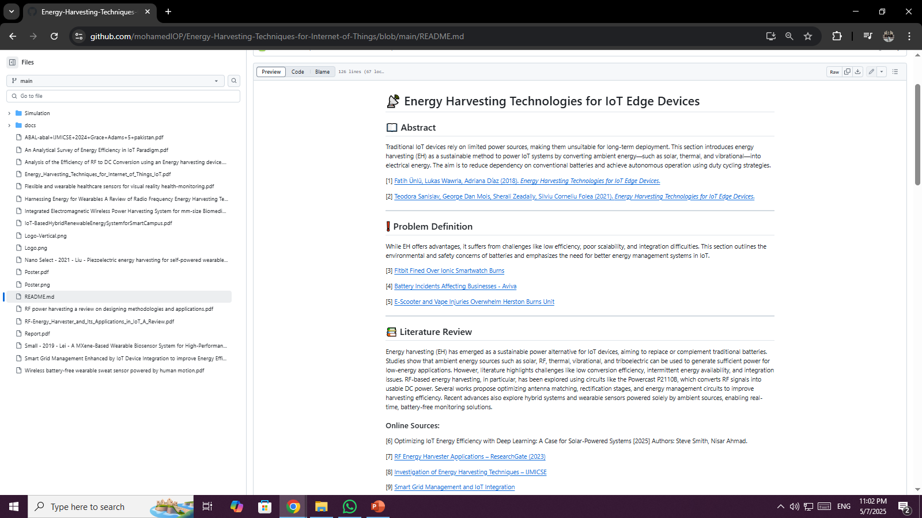
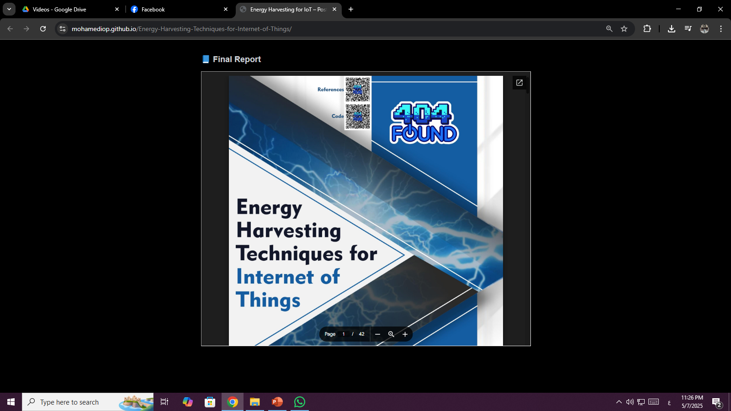
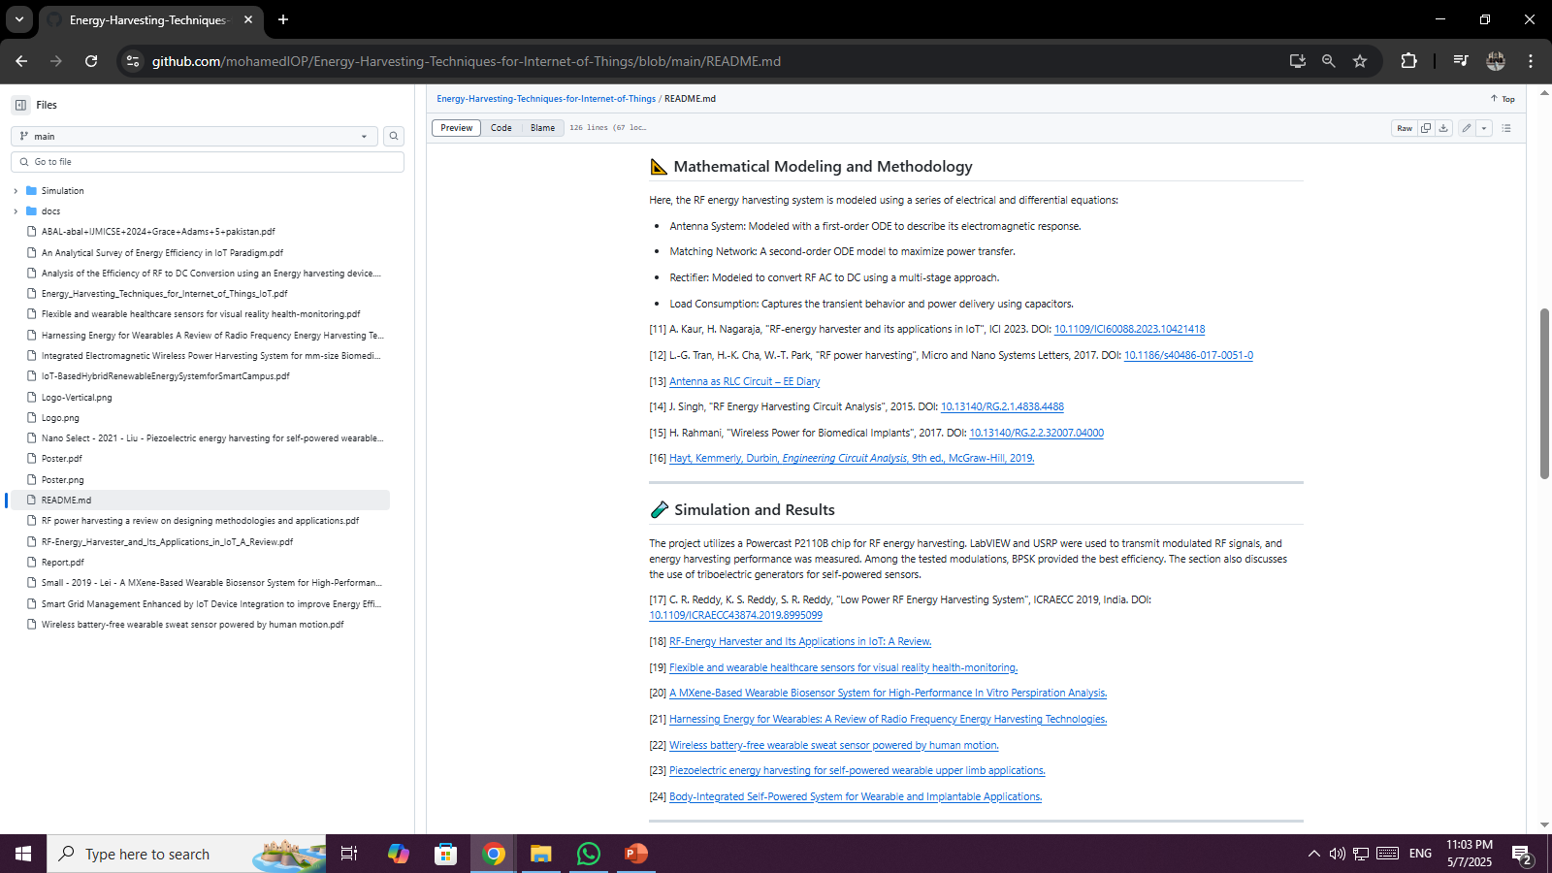
Documentation on
GitHub

Slide 14



THANK
YOU
CODE
GitHub

